Slide 1
机密容器
探讨容器技术的安全问题
揭秘机密容器的解决方案
演示机密容器在AI中的应用案例
https://github.com/huoqifeng/document/blob/master/coco/RedHat%20Broadcast%2020240627.pptx
霍启峰

Slide 2
第一篇 虚拟机及其安全

Slide 3
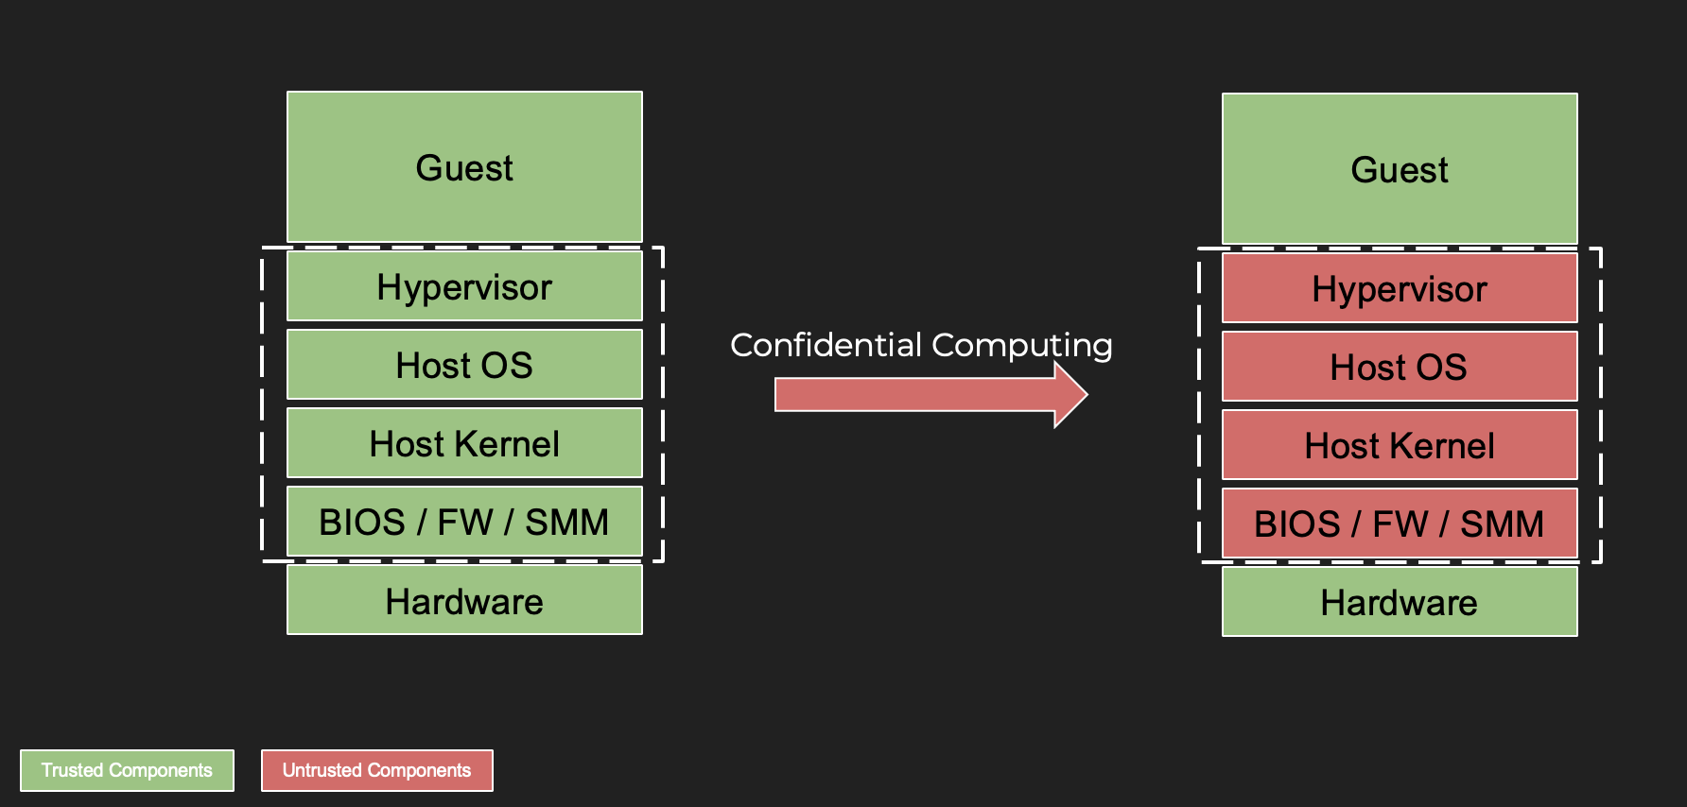
机密计算 – 云计算平台虚拟机的新安全模型

Slide 4
虚拟机的安全问题
VM
VM
VM
VM
VM
来自其他虚拟机的攻击
来自HyperVisor的攻击
HyperVisor

Slide 5
部分机密计算平台的解决方案
各个硬件供应商为增强计算平台安全性所做的努力，特别是在虚拟化和云环境中。它们提供内存加密、安全飞地和基于硬件的隔离等功能，以保护敏感数据和工作负载免受未经授权的访问和攻击, 例如：
AMD Secure Nested Paging (SNP)
Intel Total Memory Encryption (TME) and Intel Software Guard Extensions (SGX)
IBM Secure Execution for Linux （SE）
ARM Confidential Compute Architecture (CCA)
IBM Power Processor Encryption Facility (PEF)
海光 (H3C) Confidential Secure Virtualization (CSV)

Slide 6
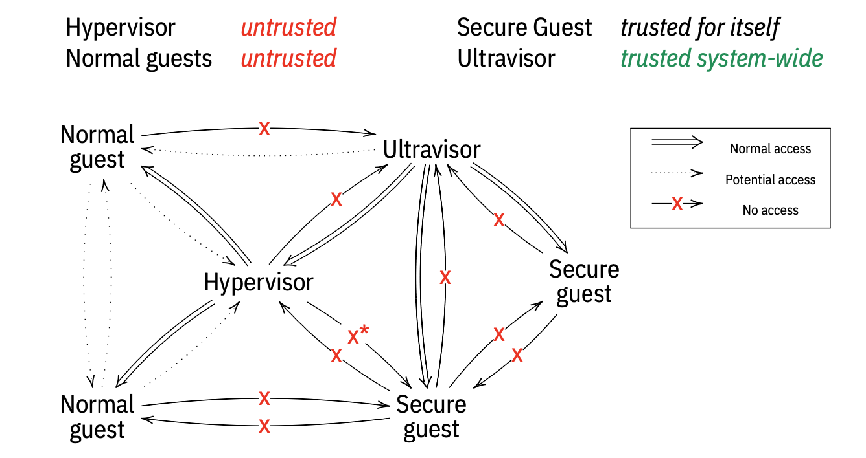
IBM Secure Excution – 零信任

Slide 7
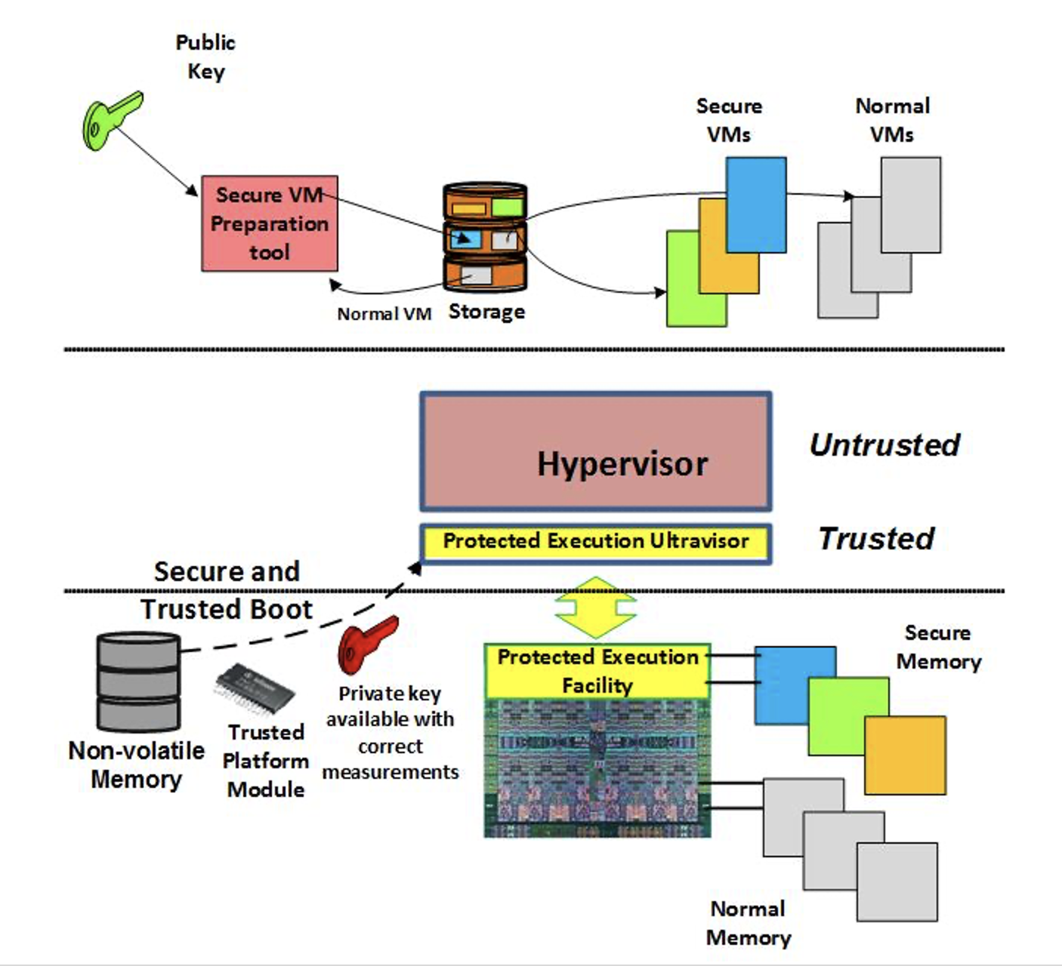
IBM Secure Excution – 内存安全

Slide 8
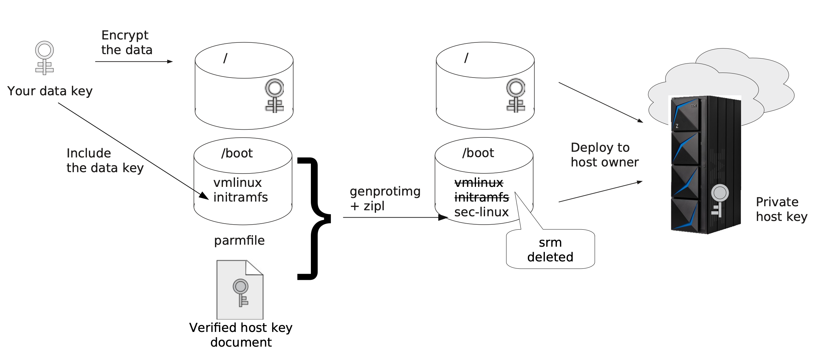
IBM Secure Excution – 数据安全

Slide 9
第二篇 容器及其安全

Slide 10
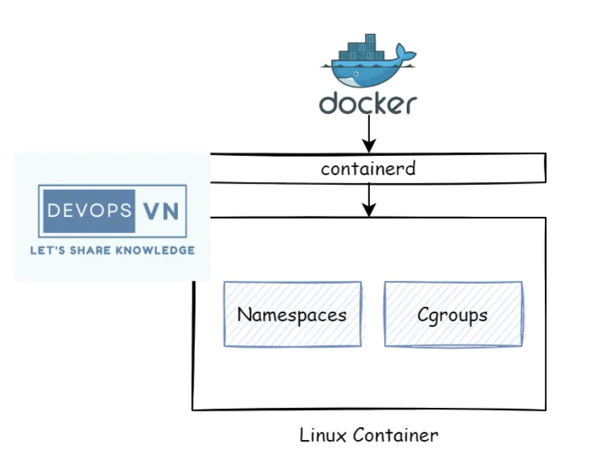
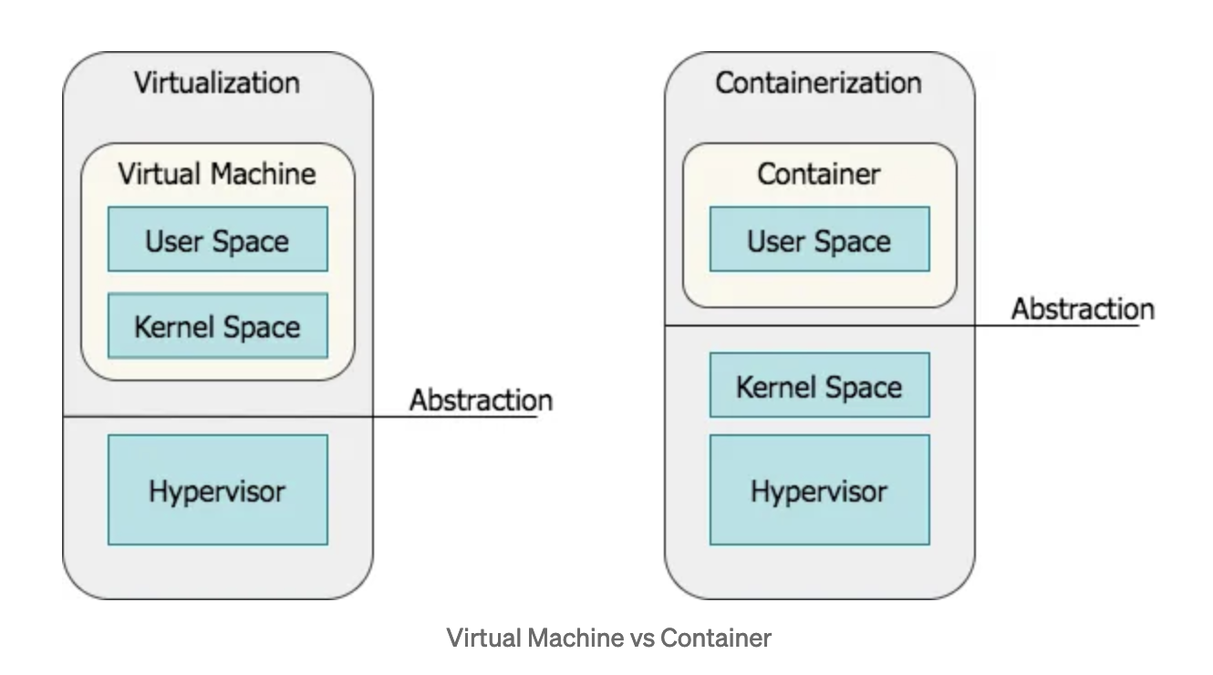
传统容器技术 – Namespace, Cgroups

Slide 11
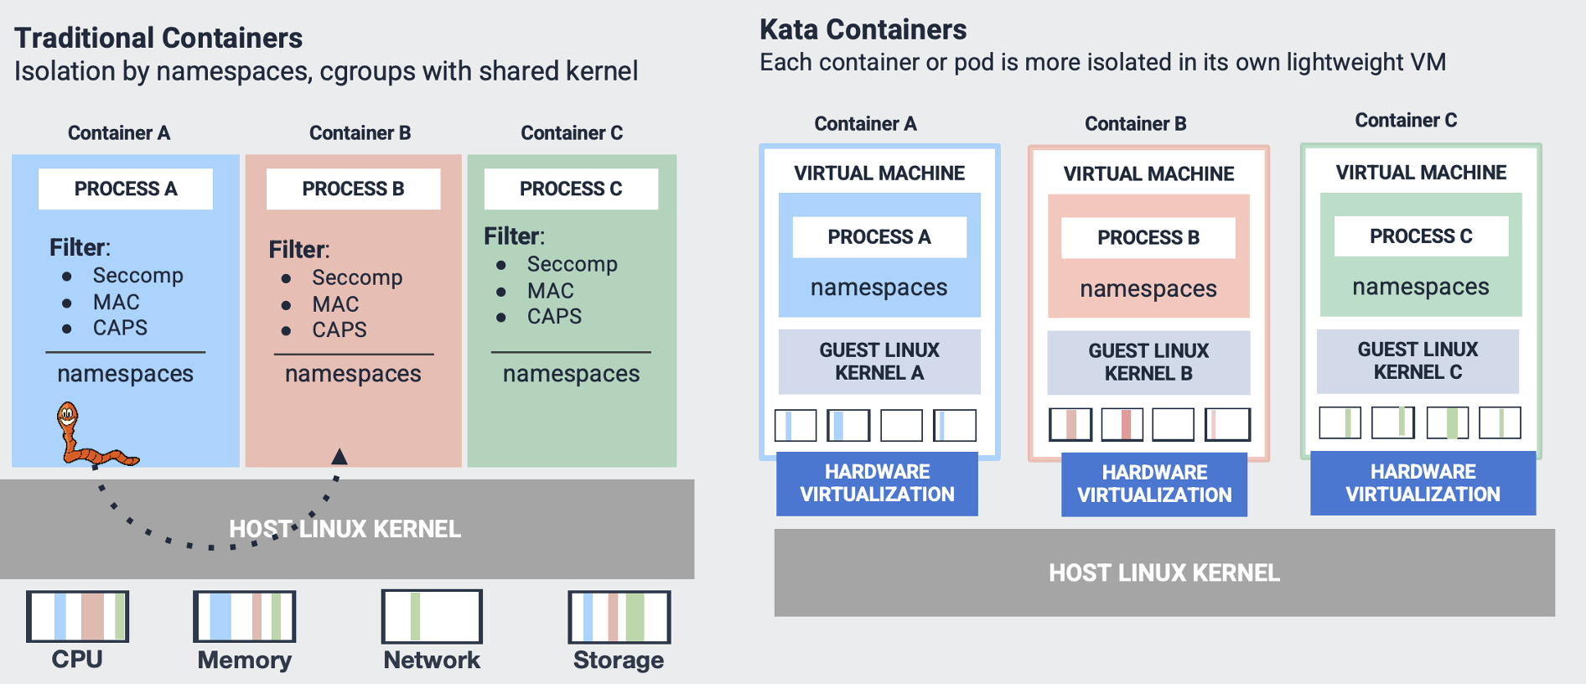
Kata Containers – 基于虚拟机的容器

Slide 12
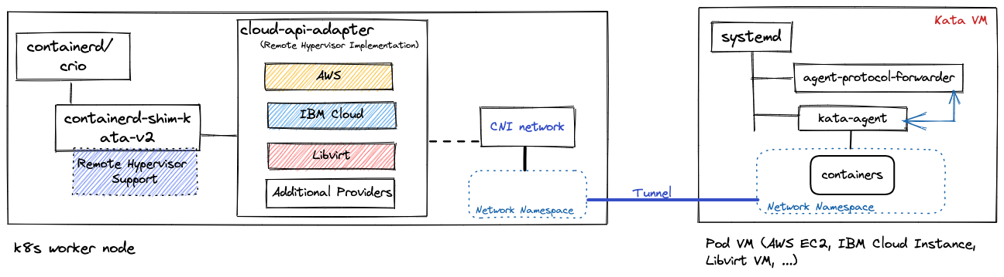
伴生容器 (Kata Remote HyperVisor + PeerPod)

Slide 13
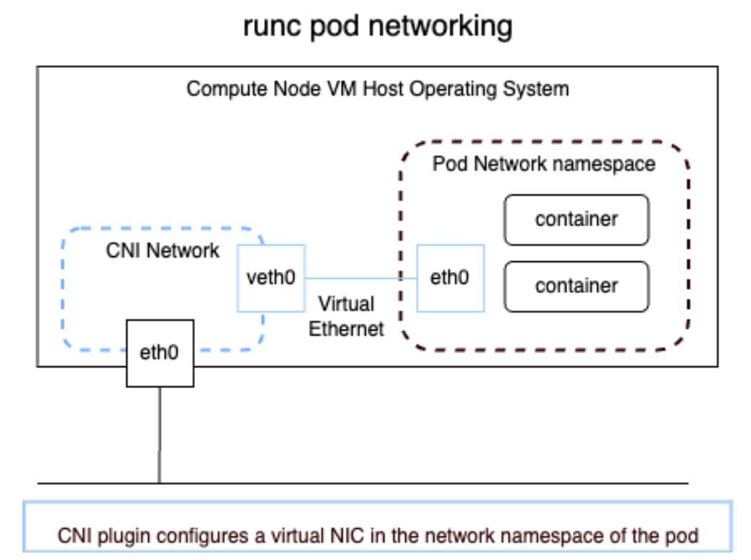
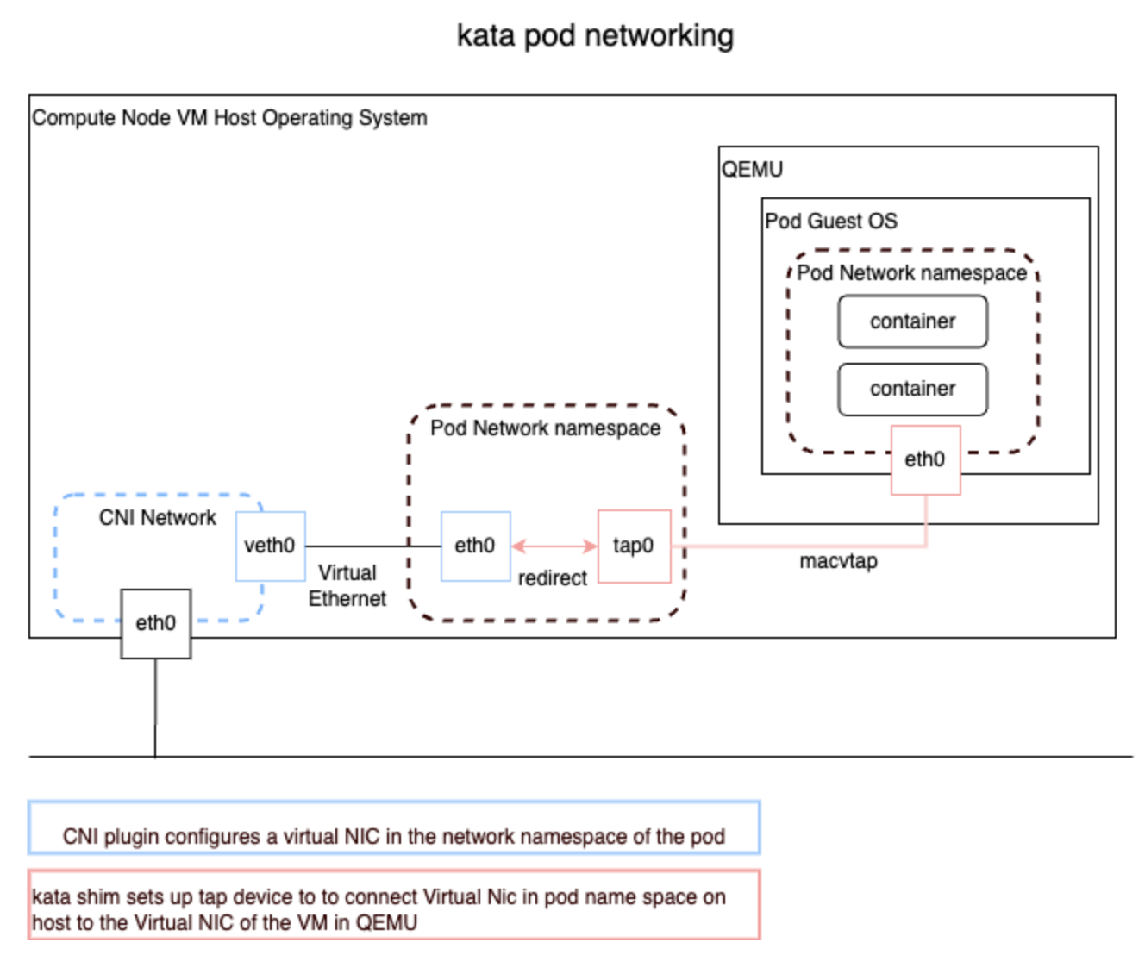
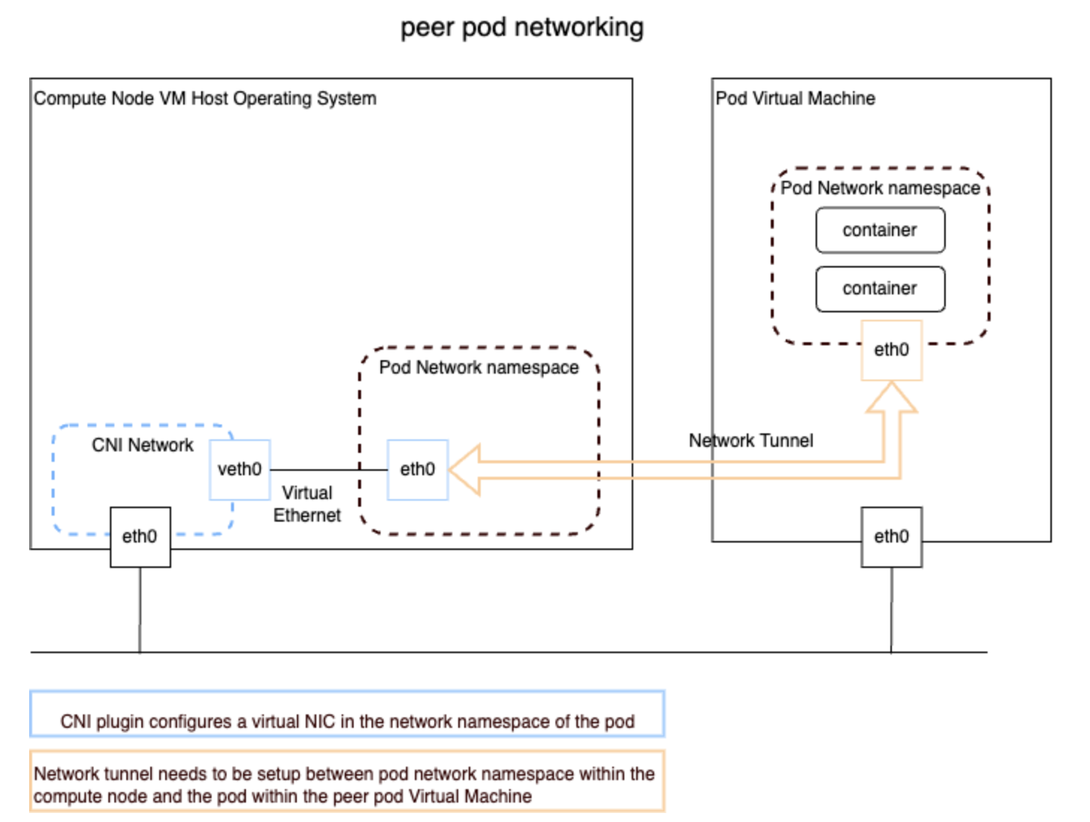
不同容器技术网络解决方案对比

Slide 14
伴生容器网络详解
Worker node VM
kubelet
IaaS cloud
API endpoint
Tunnel for agent protocol
Agent API requests and responses between kata-shim and kata-agent are transferred via a tunnel established between Cloud API Adaptor and Agent Protocol Forwarder
Tunnel for pod network
Incoming and outgoing packets of a pod running in a peer pod VM are transferred via a network tunnel between a worker node VM and peer pod VM
CRI
containerd
Shim API
kata-shim
Create
Request
Request
Agent protocol
Pod VM
Cloud API adaptor
Tunnel for agent protocol
Agent protocol forwarder
CNI
Configure
Kata agent
Create
Tunnel for pod network
Pod
Network namespace
container
CNI plugin
container
Configure
Pod network

Slide 15
伴生容器的 Volumes, secret, configmap
Worker node VM
kubelet
CRI
containerd
Shim API
kata-shim
Request
Agent protocol
Pod VM
Cloud API adaptor
Tunnel for agent protocol
Agent protocol forwarder
CopyFile
Kata agent
Create
Pod
container
Volume
Volume

Slide 16
第三篇 机密容器

Slide 17
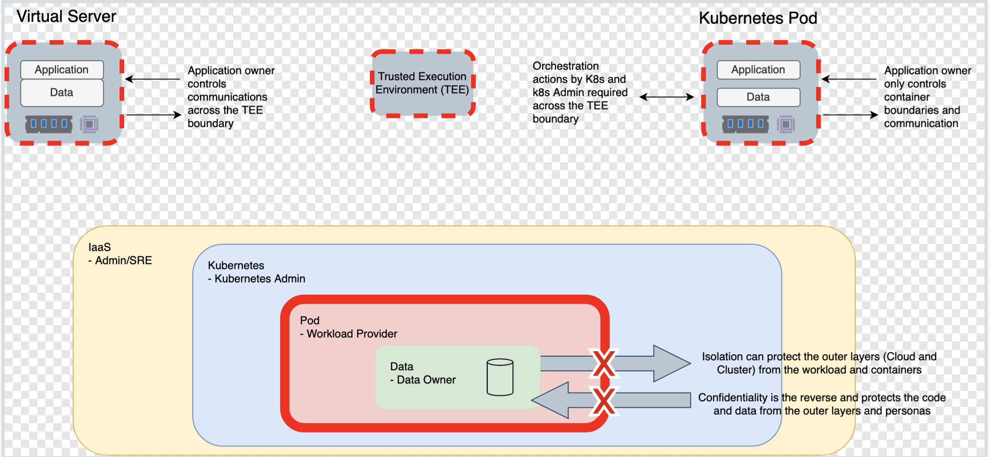
K8s 零信任

Slide 18
CNCF 机密容器项目历史
机密容器项目是标准化 Pod 级别的机密计算并简化其在 Kubernetes 中的使用。这使得 Kubernetes 用户能够使用熟悉的工作流程和工具来部署机密容器工作负载，而无需广泛了解底层机密计算技术。
Initialized in June 2020 by Intel, IBM, Redhat, Alibaba
Become CNCF Sandbox project in March 2022
Github org link and Slack channel
First relase in Sept 2022
Incubator on-going…

Slide 19
CoCo社区进展（Dec 2024）
CNCF Incubation
Website - https://confidentialcontainers.org
ARM CCA support - https://github.com/confidential-containers/trustee/issues/631
Initdata
baremetal - https://github.com/kata-containers/kata-containers/issues/9468
PeerPod - https://github.com/confidential-containers/cloud-api-adaptor/issues/1895
Confidential GPU
in PeerPod- https://github.com/confidential-containers/cloud-api-adaptor/issues/1586
Attestation - https://github.com/confidential-containers/guest-components/issues/550

Slide 20
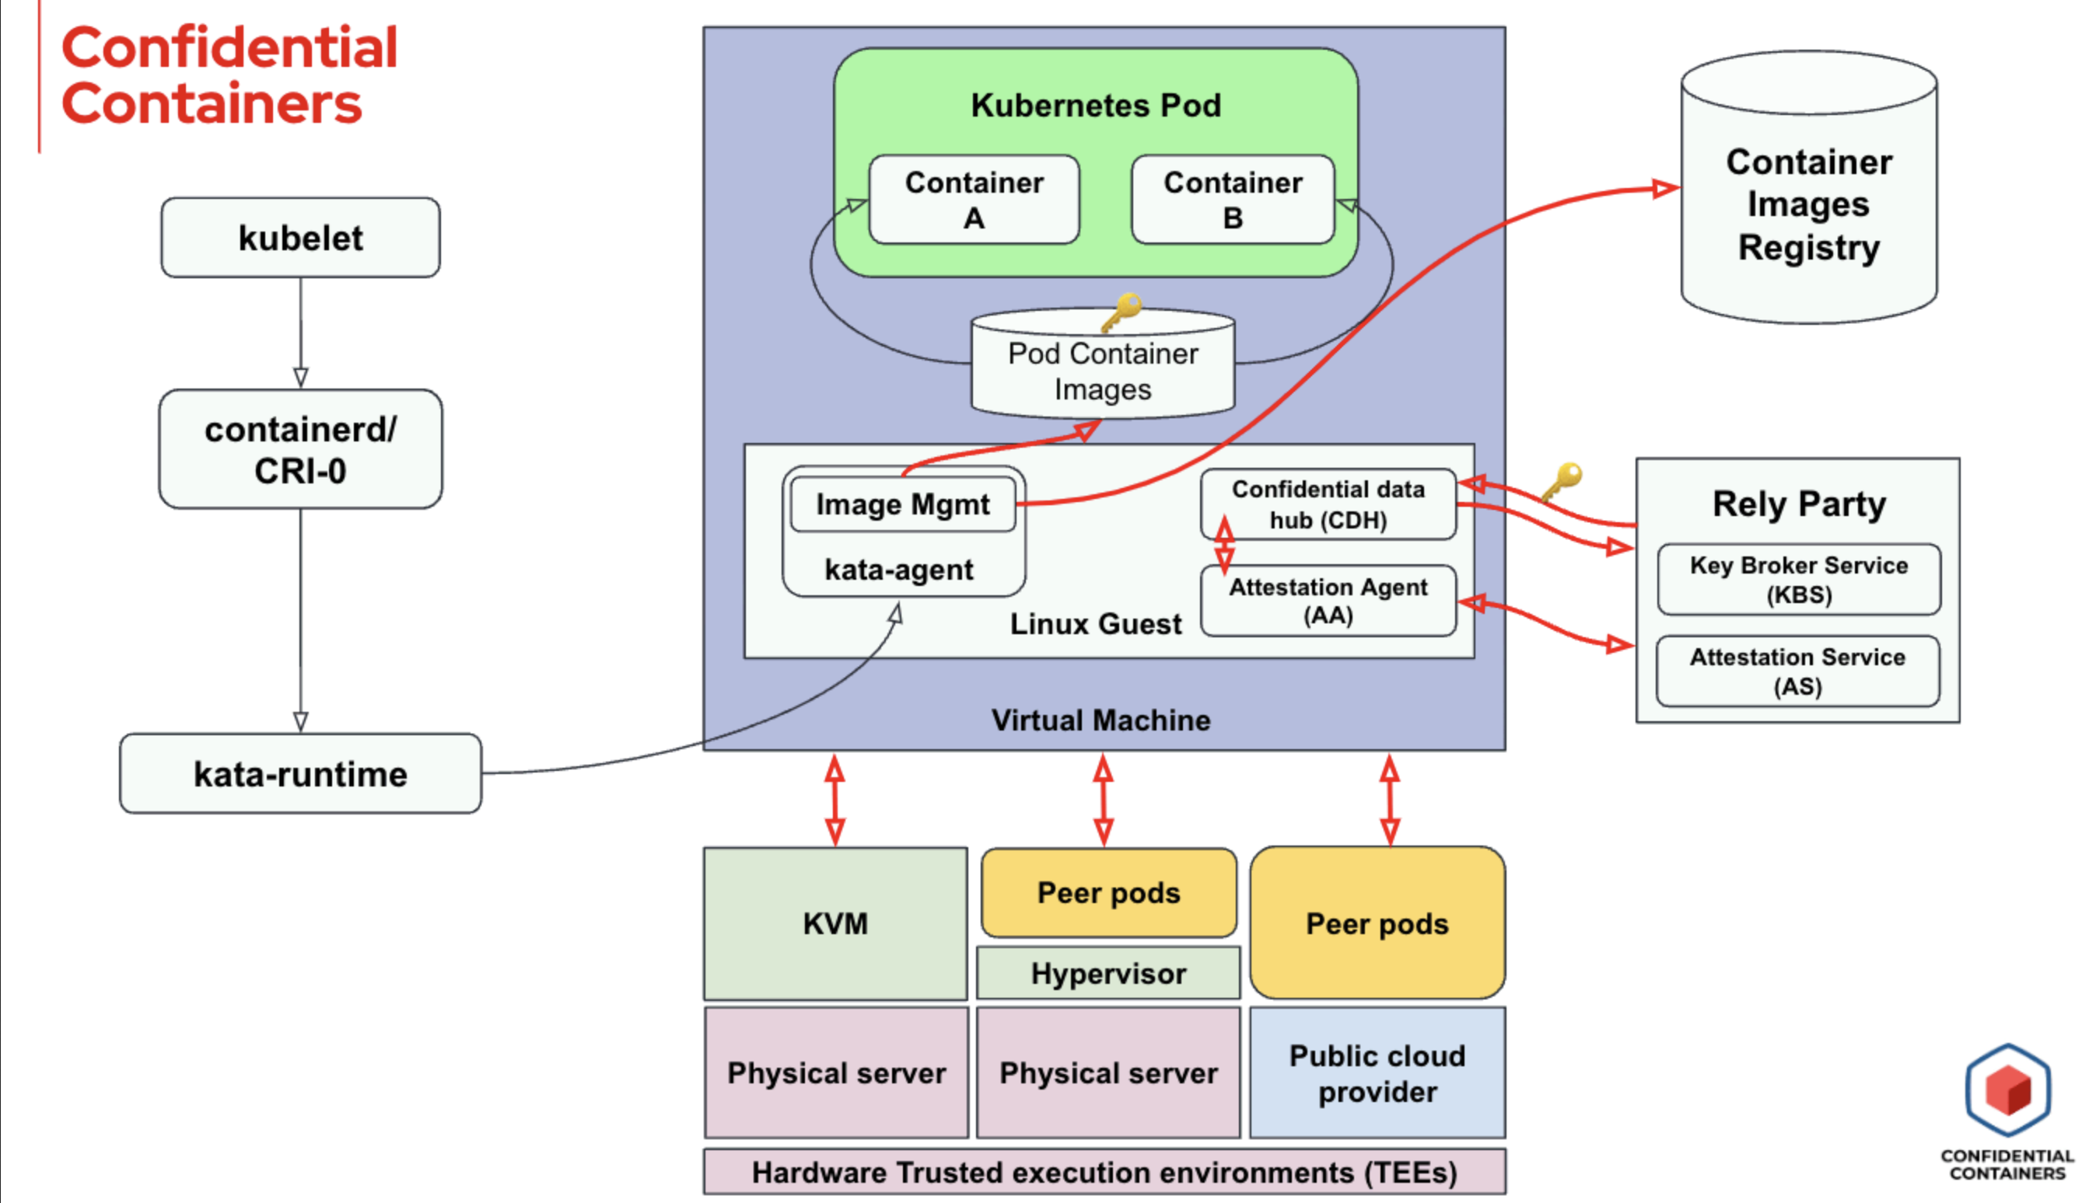
机密容器的架构

Slide 21
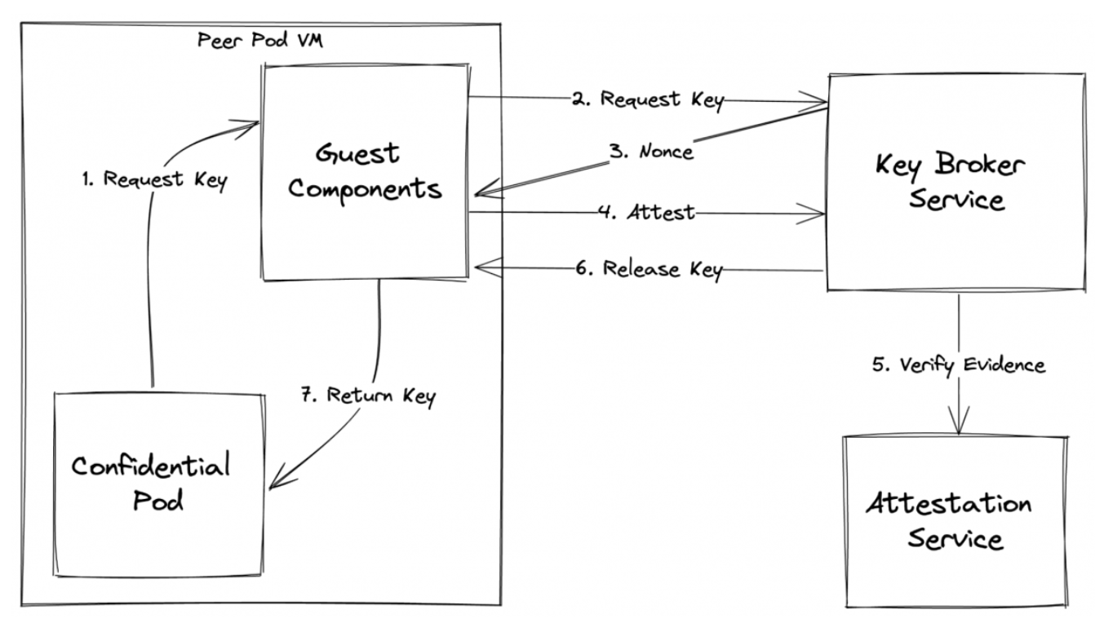
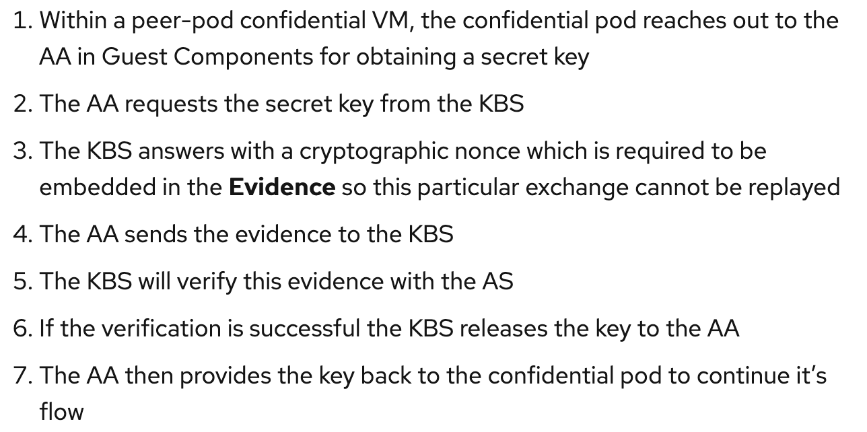
机密容器 流程详解

Slide 22
第四篇 机密容器典型用例

Slide 23
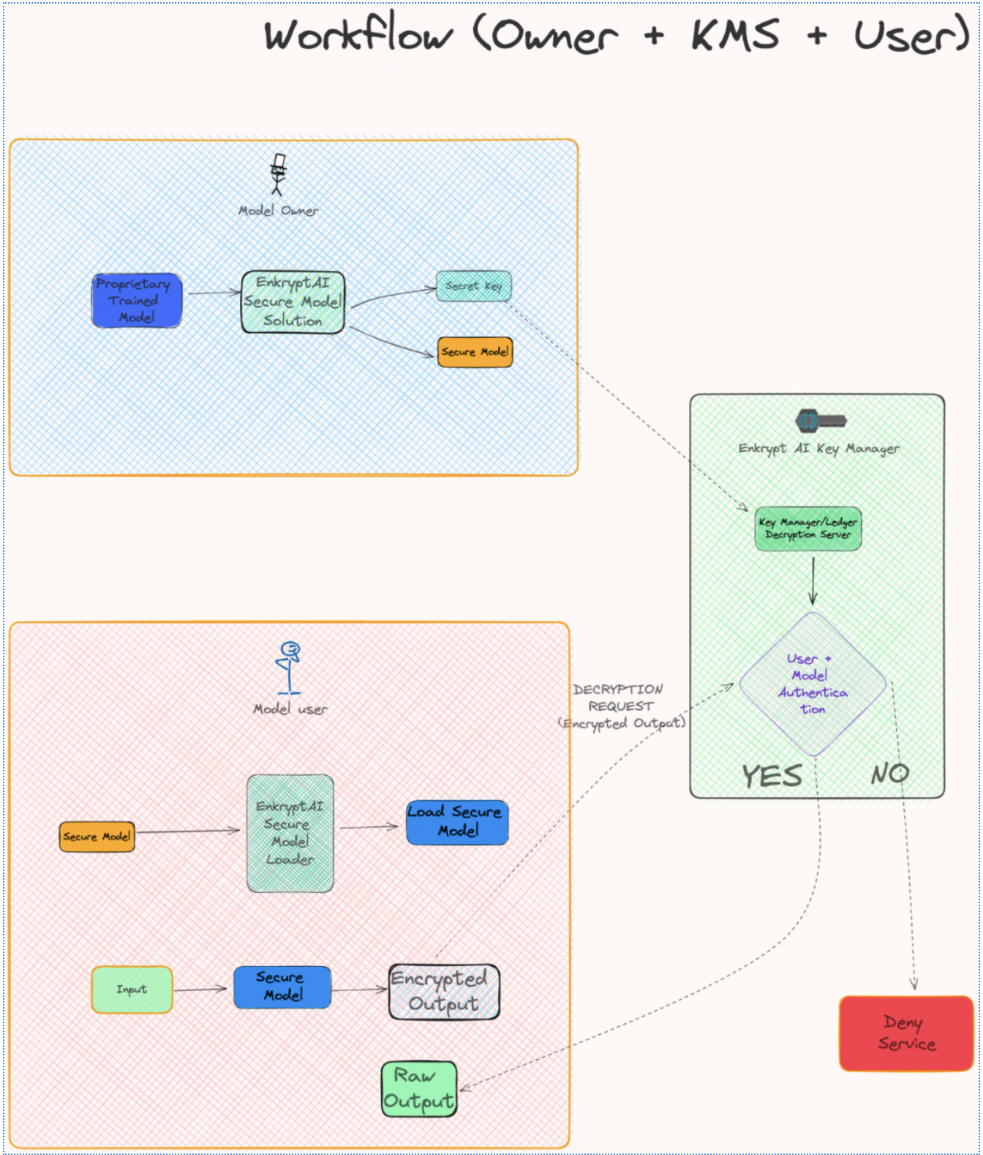
Enkrypt AI
- 模型所有者：模型开发人员，将经过训练的模型转换为安全模型
- 模型用户：希望将模型部署在其计算基础设施上的最终用户，加载安全模型并与其交互，推送数据并获取结果
- 密钥管理器：管理解密的私钥
Flow：
The model is first encrypted with enhanced security and deployed by the model owner
The model owner is the one pushing the private key into the Enkrypt AI key manager
The model user is the one sending the requests with the encrypted output to be decrypted with that key
Raw data is sent back to the model user after decryption

Slide 24
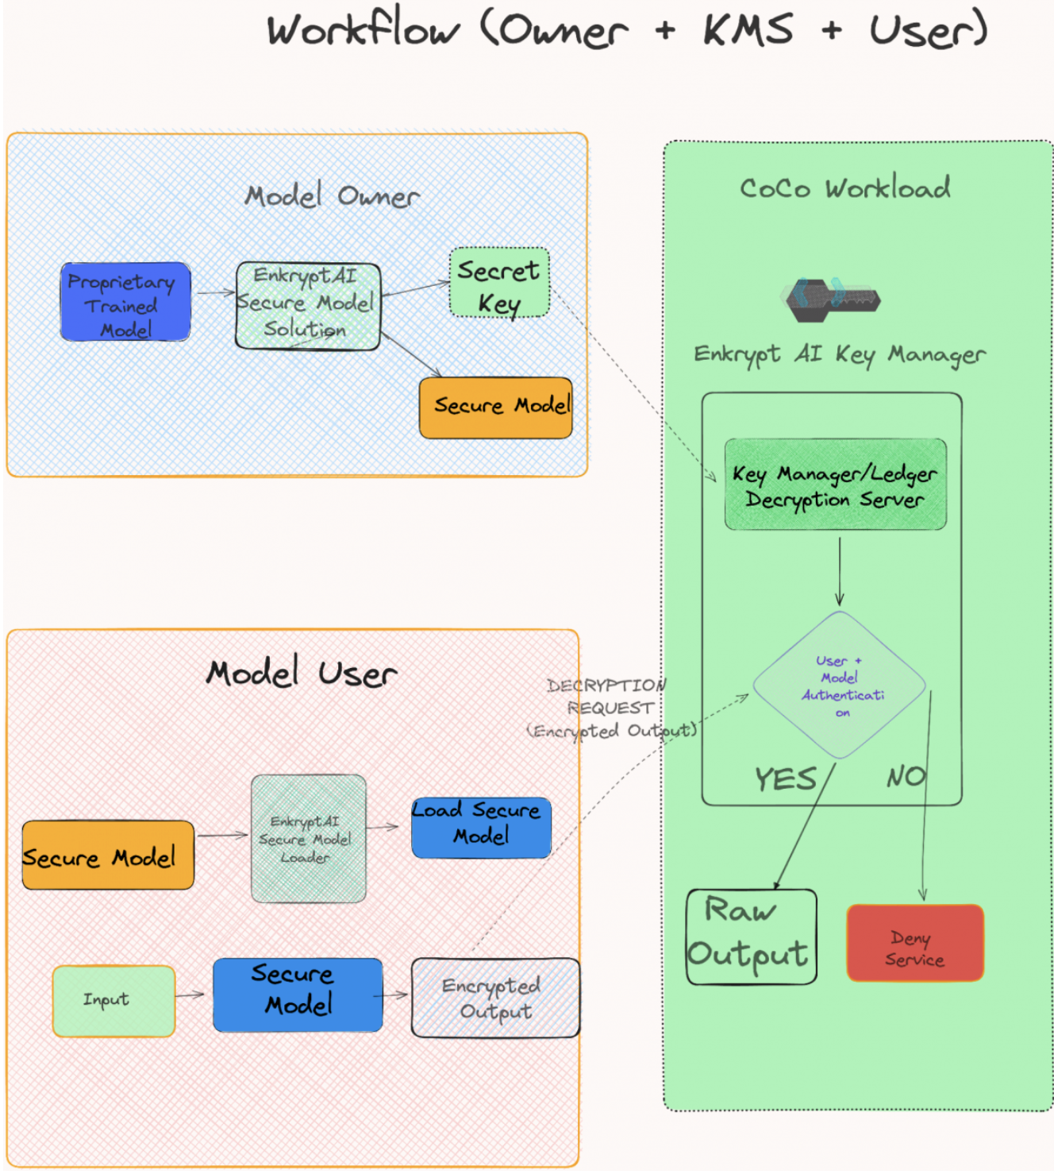
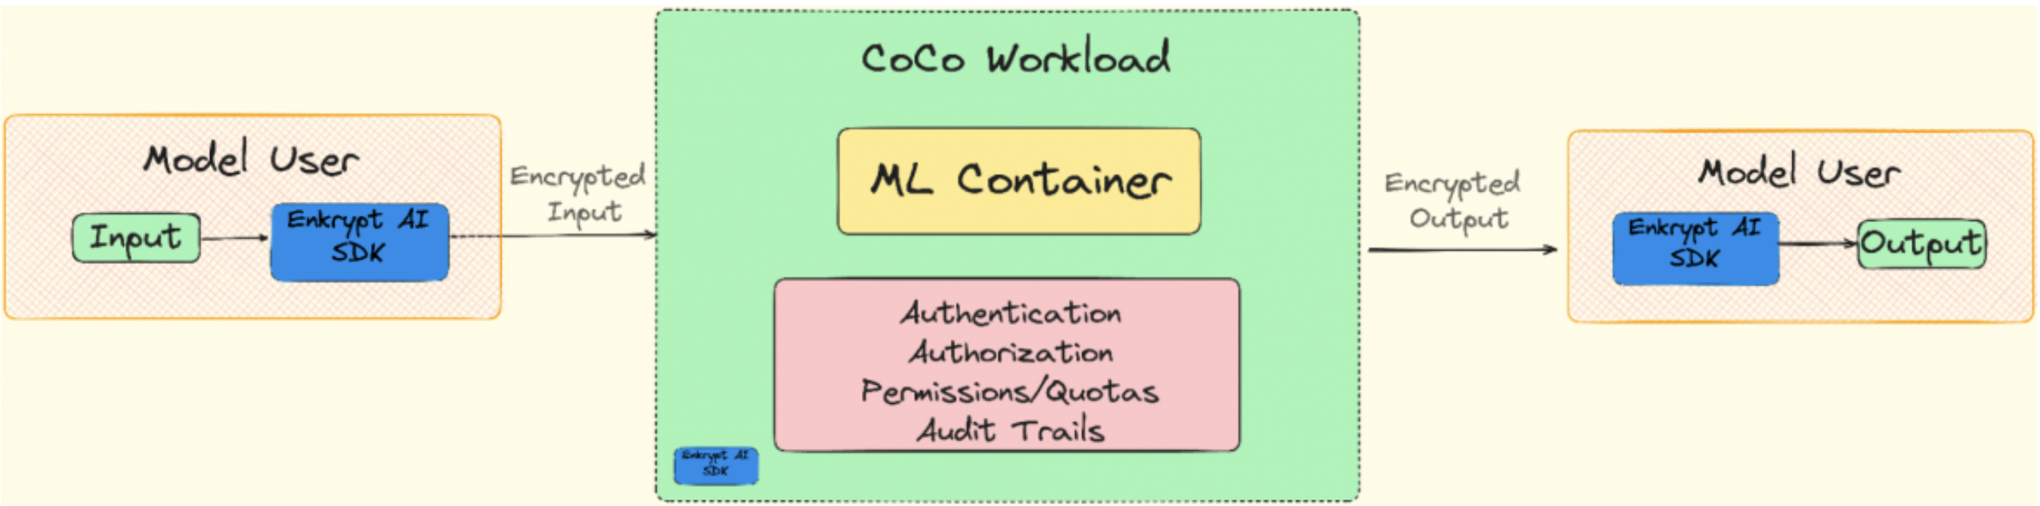
Enkrypt AI CoCo
Enkrypt AI 密钥管理器作为机密容器部署在可信执行环境中，以在运行时保护代码和密钥。

Slide 25
Demo: Securing AI Models with EnkryptAI deployed as confidential containers on Red Hat OpenShift
https://www.youtube.com/watch?v=XLOWuI7J8wE

